Slide 1

Axial and Lateral Resolution
Chapter 10

Slide 2

Resolution
Definition: the ability to image ACCURATELY
Accuracy in ultrasound can be described many ways.
Axial resolution is one measure of detail.

Slide 3
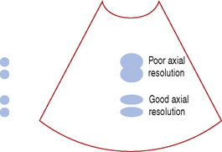
Axial Resolution
The minimum distance two reflectors can be, parallel to the beam, and still appear on the screen as two dots

Slide 4
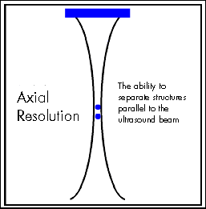
Axial Resolution
The ability of the ultrasound system to RESOLVE two separate images along the AXIS as separate structures.

Slide 5
Axial Resolution
Units - mm
Determined by SPL
Synonyms
Not adjustable
Range is 0.1 to 1.0mm
LARRD
longitudinal
axial
range
radial
depth
Actual reflectors
Shorter SPL = better axial res.
Notes:
Short pulse length better resolution than long pulse length
longitudinal, range , radial, depth resolution

Slide 6
Axial Resolution - Formula
Axial resolution (mm) = spatial pulse length (mm)
2
SPL = wavelength (mm) X # cycles in pulse
AR = wavelength (mm) X # cycles in pulse
2

Slide 7
In soft tissue wavelength (mm) = 1.54 mm/µs
F (MHz)
Axial resolution (mm) = 0.77 x # cycles in pulse
F (MHz)

Slide 8

The axial resolution of the transducer distance is 0.2 mm. What is the smallest that two reflectors can be in order to appear as two echoes on the screen?
The answer is 0.2 mm
The two reflectors have to be the same as the axial resolution of the transducer or greater in order to be displayed as two distinct echoes

Slide 9

Think of a golf score - lower # is better for axial resolution!

Slide 10
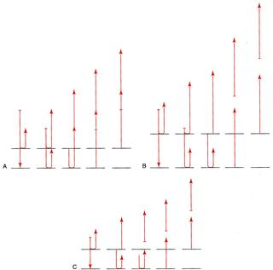
This shows a pulse hitting two reflectors.
A- Pulse hits reflectors that are less than 1/2 SPL causing the echo to overlap and not be seen as two separate echoes.
B- Pulse hits reflectors that are greater than 1/2 SPL causing there to be no overlap, so we see two separate echoes.
C- Reflector separation is the same as A, but the pulse has been reduced so we two separate echoes.

Slide 11
What allows some transducers to have better axial resolution than others?
Less ringing
The second pulse is shorter because it only contains 1 cycle, therefore it rings LESS.

Slide 12


More cars (cycles) in train (pulse), MORE ringing
IMPROVE AXIAL RESOLUTION:
Shorten the number of cycles (cars) - to shorten the pulse
Less cars (cycles) in train (pulse) LESS ringing!

Slide 13
Higher Frequency
A train is short if each car is short.
Both pulses contain 4 cycles;
lower example is shorter
has higher frequency sound
shorter wavelengths
= AR

Slide 14
In clinical sonographic imaging pulses typically have 2-3 cycles.

Slide 15
Review Please!
Characteristics that distinguish:
pulses with long pulse length from those with
short pulse length:
Long pulse length characteristics:
many cycles in the pulse
cycles with longer wavelengths
Short pulse length characteristics:
Short pulses are created by
fewer cycles in the pulse
cycles with shorter wavelengths

Slide 16
Superior Axial Resolution
Shorter pulse length
Shorter pulse duration
Higher frequencies (shorter wavelength)
Fewer cycles per pulse (less ringing)
Lower numeric values = higher axial res.

Slide 17
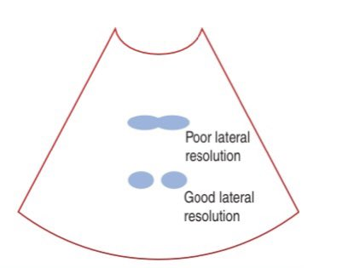
Lateral Resolution
Refers to the width of the beam and the reflectors that lie perpendicular to it

Slide 18
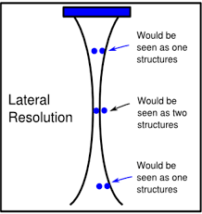
Lateral Resolution
Minimum distance that two structures are separated side to side or perpendicular to the sound beam that will produce two different echoes.
Lateral resolution varies with depth since beam diameter varies with depth
When two side by side structures are closer together than the beam width, only one reflection is seen on the image

Slide 19
Lateral Resolution
Also called angular, transverse, azimuthal
LATA
lateral
angular
transverse
azimuthal

Slide 20
Transducer w/ a narrow beam
Transducer with a wide beam
What our machine sees

Slide 21
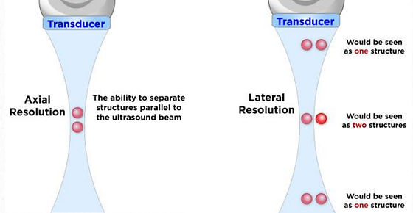
Axial vs. lateral resoulution

Slide 22
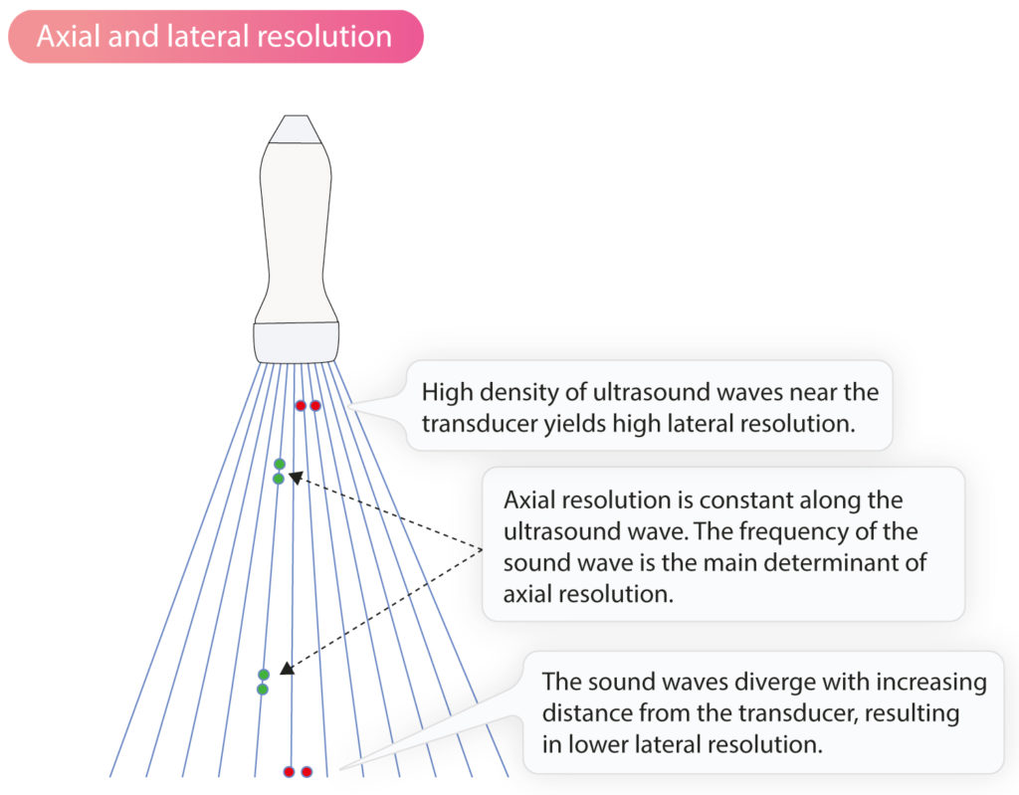
Axial vs. lateral resoulution

Slide 23

Focusing
Concentrates the sound energy into a narrow beam
Alters the beam in 4 ways:
Narrower beam diameter in near field and focal zone
Decrease in focal depth (focus is shallower)
Focal zone is smaller
Beam diameter in the far zone increases
Effective mainly in the near field and focal zone

Slide 24
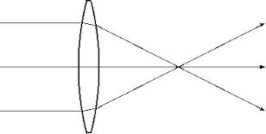
Focusing
Two types of focusing:
Fixed (conventional/mechanical)
Focal depth and extent of focusing cannot be changed
Adjustable by electronics – called a phased array transducer.
PHASED ARRAY MEANS adjustable or multiple focusing.

Slide 25
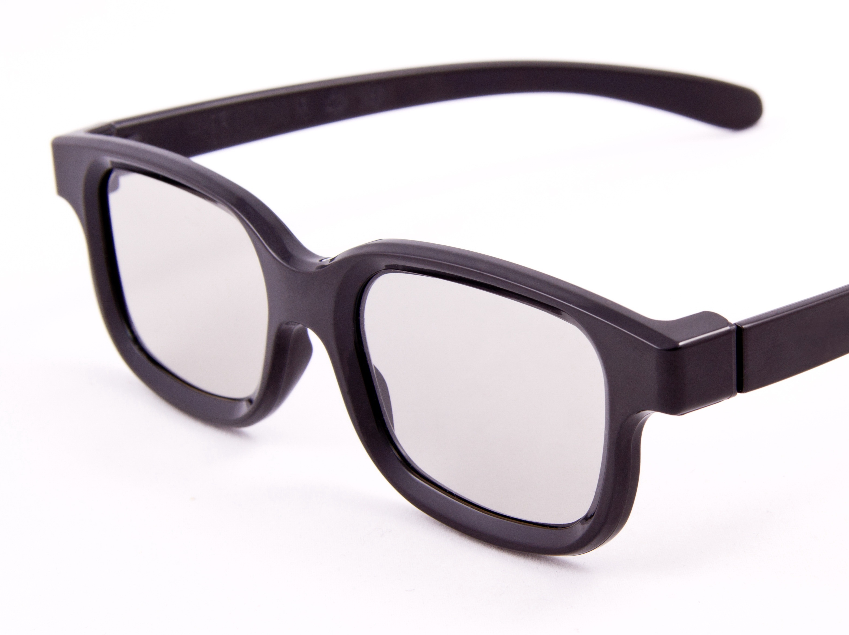
Focusing
Three methods of focusing
Lens-external focusing (fixed)-
Like wearing glasses- external
Curved Crystal (fixed)
Like having lasik - internal
Electronic Focusing (adjustable)

Slide 26
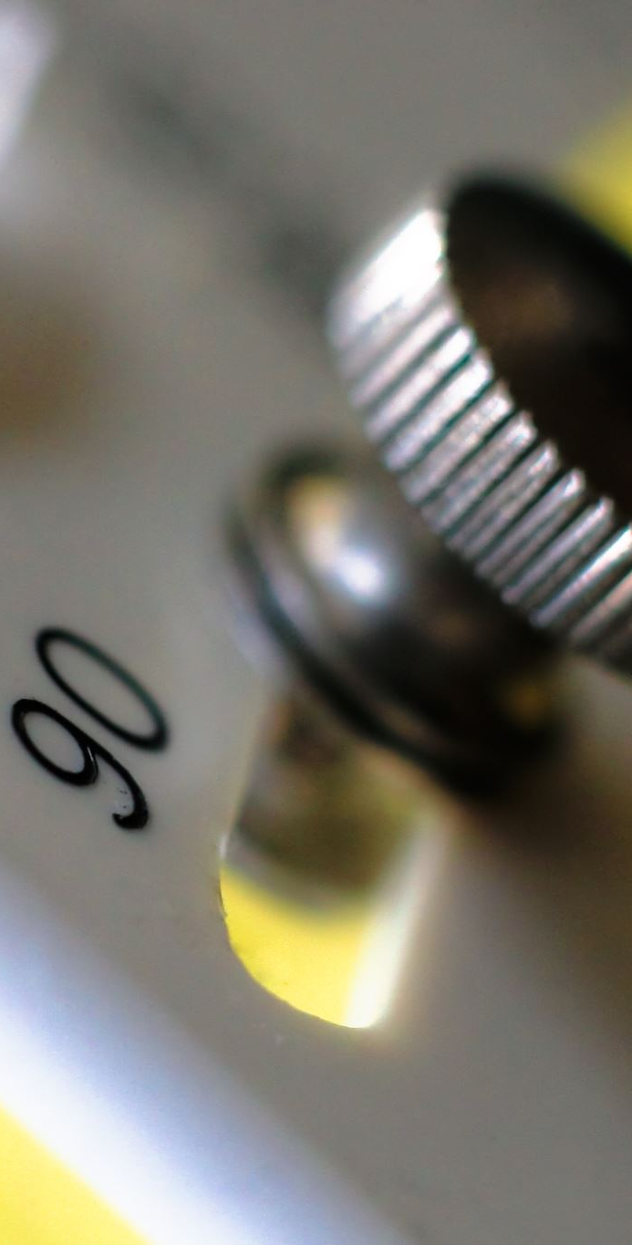
Focusing
Fixed focus transducers
have the poorest lateral resolution since the focal depth is fixed and cannot be adjusted.
Single crystal transducers
always fixed focus
Phased array transducers
generally, have better lateral resolution because the focus is adjustable by the sonographer
The greater the extent of focusing, the smaller the focal zone

